Slide 1
Introduction to Deep Learning: Algorithms and Their Applications
CDC Short Course
Xiaoming Huo, Georgia Tech

Slide 2
Schedule
8:30-9:30 Module 1: Introduction
9:45-10:45 Module 2: Overview & preparation
11:00-12:00 Module 3: Neural networks - basics
12:00-1:15 Lunch break
1:15-2:00 Module 4: Neural networks - models
2:15-3:00 Module 5: Convolutional neural networks
3:15-4:00 Module 6: Some examples
4:00 Adjourn
Online resources: https://github.com/xhuo17/CDC_DL_2022

Slide 3
How an Neural Network Model Work? A Linear Algebra Perspective

Slide 4
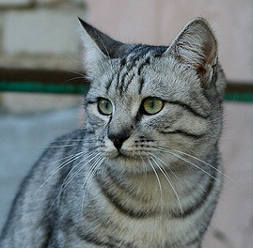
Parametric Approach: Linear Classifier
3072x1
f(x,W) = Wx + b
10x1
Image
10x1
10x3072
f(x,W)
10 numbers giving class scores
Array of 32x32x3 numbers
(3072 numbers total)
W
parameters
or weights
Slide Credit: Fei-Fei Li, Justin Johnson, Serena Yeung, CS 231n

Slide 5
Example with an image with 4 pixels, and 3 classes (cat/dog/ship)
Stretch pixels into column
56
231
24
2
56 | 231
24 | 2
Input image
Slide Credit: Fei-Fei Li, Justin Johnson, Serena Yeung, CS 231n

Slide 6
Example with an image with 4 pixels, and 3 classes (cat/dog/ship)
Stretch pixels into column
56
231
24
2
0.2 | -0.5 | 0.1 | 2.0
1.5 | 1.3 | 2.1 | 0.0
0 | 0.25 | 0.2 | -0.3
1.1
3.2
-1.2
-96.8
437.9
61.95
Cat score
56 | 231
24 | 2
+
=
Dog score
Ship score
Input image
W
b
Slide Credit: Fei-Fei Li, Justin Johnson, Serena Yeung, CS 231n

Slide 7
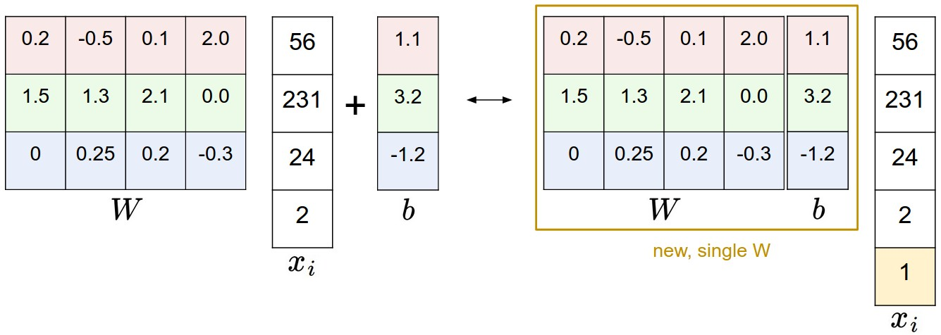
Image Credit: Andrej Karpathy, CS231n

Slide 8
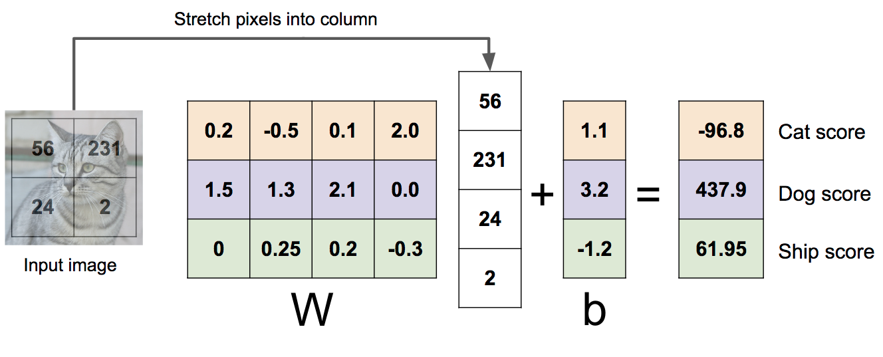
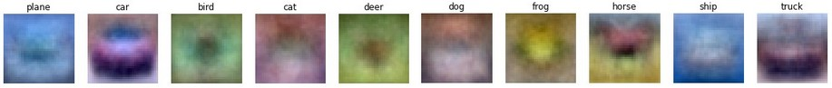
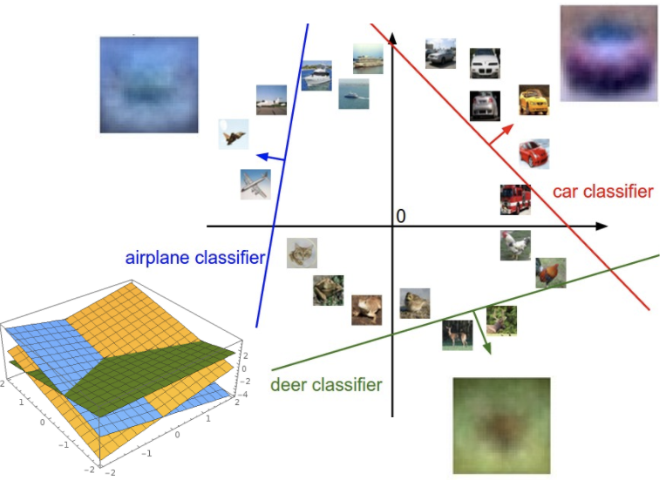
Linear Classifier: Three Viewpoints
Algebraic Viewpoint
Visual Viewpoint
Geometric Viewpoint
f(x,W) = Wx
One template per class
Hyperplanes cutting up space
Slide Credit: Fei-Fei Li, Justin Johnson, Serena Yeung, CS 231n

Slide 9
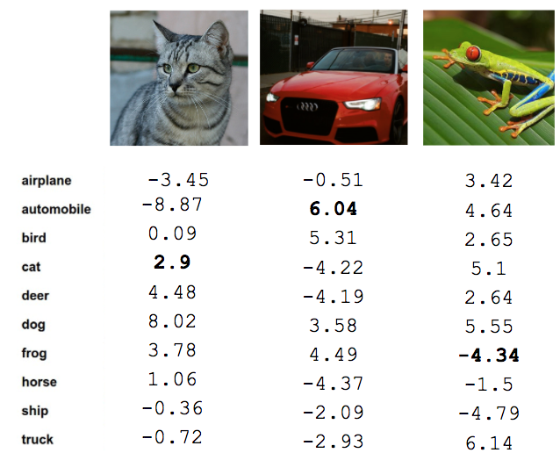
Linear Classifier
TODO:
Define a loss function that quantifies our unhappiness with the scores across the training data.
Come up with a way of efficiently finding the parameters that minimize the loss function. (optimization)
Cat image by Nikita is licensed under CC-BY 2.0; Car image is CC0 1.0 public domain; Frog image is in the public domain
Slide Credit: Fei-Fei Li, Justin Johnson, Serena Yeung, CS 231n

Slide 10
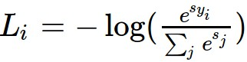

Softmax vs. SVM
Slide Credit: Fei-Fei Li, Justin Johnson, Serena Yeung, CS 231n

Slide 11
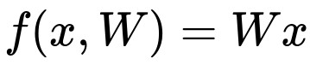
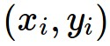
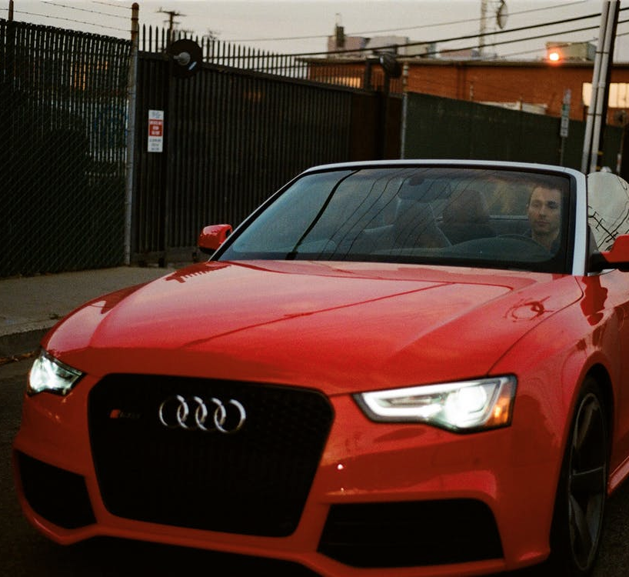
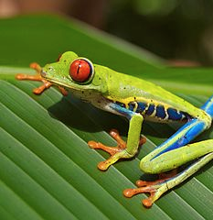
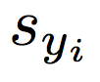
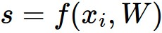
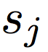
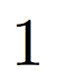
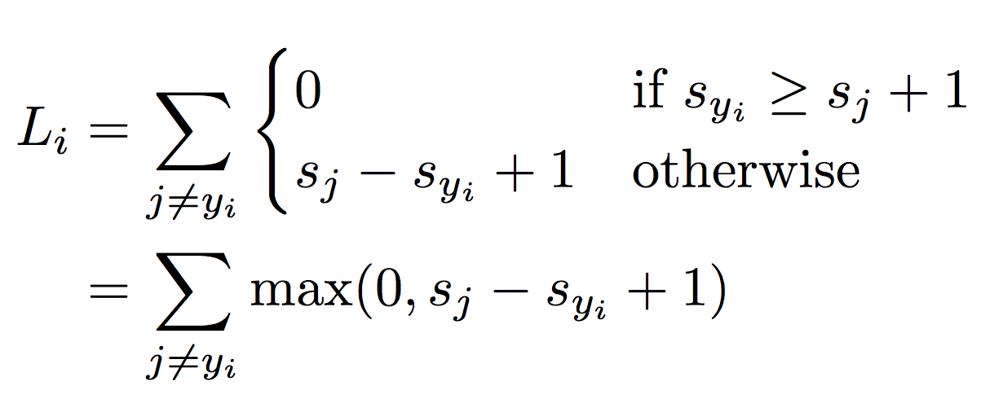
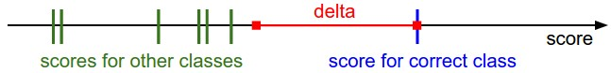
Suppose: 3 training examples, 3 classes.
With some W the scores are:
Multiclass SVM loss:
Given an example
where is the image and
where is the (integer) label,
and using the shorthand for the scores vector:
the SVM loss has the form:
“Hinge loss”
cat
3.2
1.3
2.2
car
5.1
4.9
2.5
frog
-1.7
2.0
-3.1
Slide Credit: Fei-Fei Li, Justin Johnson, Serena Yeung, CS 231n

Slide 12
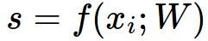
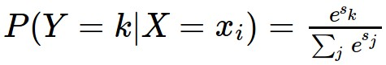
Softmax Classifier (Multinomial Logistic Regression)
Want to interpret raw classifier scores as probabilities
Softmax Function
cat
3.2
car
5.1
frog
-1.7
Slide Credit: Fei-Fei Li, Justin Johnson, Serena Yeung, CS 231n

Slide 13
Softmax Classifier (Multinomial Logistic Regression)
Want to interpret raw classifier scores as probabilities
Softmax Function
Probabilities must be >= 0
cat
3.2
24.5
exp
car
5.1
164.0
frog
-1.7
0.18
unnormalized probabilities
Slide Credit: Fei-Fei Li, Justin Johnson, Serena Yeung, CS 231n

Slide 14
Softmax Classifier (Multinomial Logistic Regression)
Want to interpret raw classifier scores as probabilities
Softmax Function
Probabilities must be >= 0
Probabilities must sum to 1
cat
3.2
24.5
0.13
exp
normalize
car
5.1
164.0
0.87
frog
-1.7
0.18
0.00
unnormalized probabilities
probabilities
Slide Credit: Fei-Fei Li, Justin Johnson, Serena Yeung, CS 231n

Slide 15
Softmax Classifier (Multinomial Logistic Regression)
Want to interpret raw classifier scores as probabilities
Softmax Function
Probabilities must be >= 0
Probabilities must sum to 1
cat
3.2
24.5
0.13
exp
normalize
car
5.1
164.0
0.87
frog
-1.7
0.18
0.00
Unnormalized log-probabilities / logits
unnormalized probabilities
probabilities
Slide Credit: Fei-Fei Li, Justin Johnson, Serena Yeung, CS 231n

Slide 16
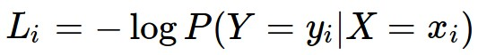
Softmax Classifier (Multinomial Logistic Regression)
Want to interpret raw classifier scores as probabilities
Softmax Function
Probabilities must be >= 0
Probabilities must sum to 1
cat
3.2
24.5
0.13
L_{i} = -log(0.13)
= 2.04
exp
normalize
car
5.1
164.0
0.87
frog
-1.7
0.18
0.00
Unnormalized log-probabilities / logits
unnormalized probabilities
probabilities
Slide Credit: Fei-Fei Li, Justin Johnson, Serena Yeung, CS 231n

Slide 17
Softmax Classifier (Multinomial Logistic Regression)
Want to interpret raw classifier scores as probabilities
Softmax Function
Probabilities must be >= 0
Probabilities must sum to 1
cat
3.2
24.5
0.13
L_{i} = -log(0.13)
= 2.04
exp
normalize
car
5.1
164.0
0.87
-1.7
0.18
0.00
Maximum Likelihood Estimation
Choose probabilities to maximize the likelihood of the observed data
frog
Unnormalized log-probabilities / logits
unnormalized probabilities
probabilities
Slide Credit: Fei-Fei Li, Justin Johnson, Serena Yeung, CS 231n

Slide 18
Softmax Classifier (Multinomial Logistic Regression)
Want to interpret raw classifier scores as probabilities
Softmax Function
Probabilities must be >= 0
Probabilities must sum to 1
cat
3.2
24.5
0.13
compare
1.00
exp
normalize
car
5.1
164.0
0.87
0.00
frog
-1.7
0.18
0.00
0.00
Unnormalized log-probabilities / logits
unnormalized probabilities
probabilities
Correct
probs
Slide Credit: Fei-Fei Li, Justin Johnson, Serena Yeung, CS 231n

Slide 19
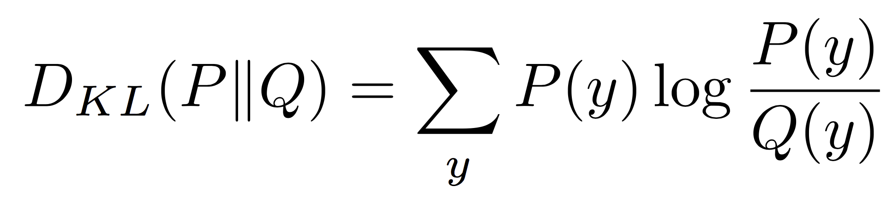
Softmax Classifier (Multinomial Logistic Regression)
Want to interpret raw classifier scores as probabilities
Softmax Function
Probabilities must be >= 0
Probabilities must sum to 1
cat
3.2
24.5
0.13
compare
1.00
exp
normalize
Kullback–Leibler divergence
car
5.1
164.0
0.87
0.00
frog
-1.7
0.18
0.00
0.00
Unnormalized log-probabilities / logits
unnormalized probabilities
probabilities
Correct
probs
Slide Credit: Fei-Fei Li, Justin Johnson, Serena Yeung, CS 231n
Notes:
Mention that this is useful for cases where you might have some target probability distribution instead of just one correct class, due to uncertainty in the model; also mention distillation

Slide 20
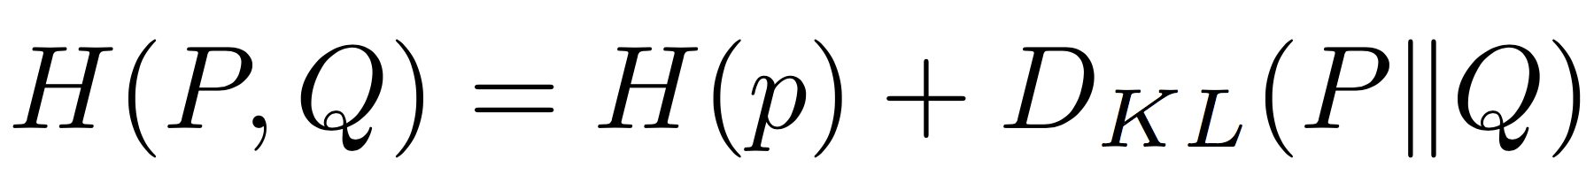
Softmax Classifier (Multinomial Logistic Regression)
Want to interpret raw classifier scores as probabilities
Softmax Function
Probabilities must be >= 0
Probabilities must sum to 1
cat
3.2
24.5
0.13
compare
1.00
exp
normalize
car
5.1
164.0
0.87
Cross Entropy
0.00
frog
-1.7
0.18
0.00
0.00
Unnormalized log-probabilities / logits
unnormalized probabilities
probabilities
Correct
probs
Slide Credit: Fei-Fei Li, Justin Johnson, Serena Yeung, CS 231n
Notes:
Mention that this is useful for cases where you might have some target probability distribution instead of just one correct class, due to uncertainty in the model; also mention distillation

Slide 21
Role of Regularization

Slide 22
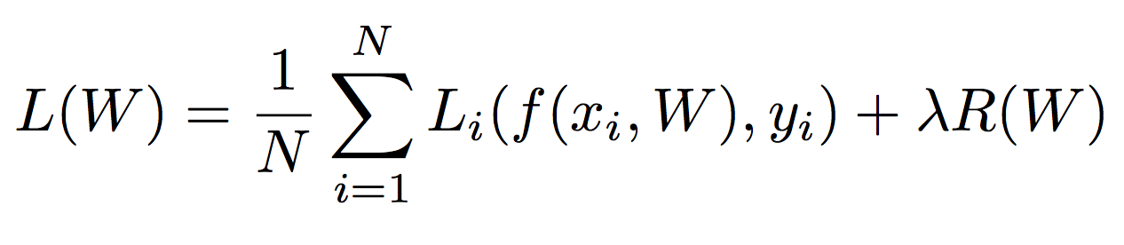
Regularization
Data loss: Model predictions should match training data
Slide Credit: Fei-Fei Li, Justin Johnson, Serena Yeung, CS 231n

Slide 23
Regularization
Data loss: Model predictions should match training data
Regularization: Prevent the model from doing too well on training data
Slide Credit: Fei-Fei Li, Justin Johnson, Serena Yeung, CS 231n

Slide 24
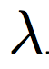
Regularization
= regularization strength
(hyperparameter)
Data loss: Model predictions should match training data
Regularization: Prevent the model from doing too well on training data
Slide Credit: Fei-Fei Li, Justin Johnson, Serena Yeung, CS 231n

Slide 25
Regularization Intuition in Polynomial Regression
y
x
Slide Credit: Fei-Fei Li, Justin Johnson, Serena Yeung, CS 231n

Slide 26
Polynomial Regression
f
y
x
Slide Credit: Fei-Fei Li, Justin Johnson, Serena Yeung, CS 231n

Slide 27
Regularization: Prefer Simpler Models
f₁
f₂
y
x
Regularization pushes against fitting the data too well so we don’t fit noise in the data
Slide Credit: Fei-Fei Li, Justin Johnson, Serena Yeung, CS 231n

Slide 28
Regularization
= regularization strength
(hyperparameter)
Data loss: Model predictions should match training data
Regularization: Prevent the model from doing too well on training data
Slide Credit: Fei-Fei Li, Justin Johnson, Serena Yeung, CS 231n

Slide 29
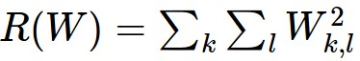
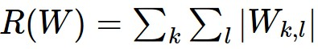
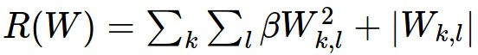
Regularization
= regularization strength
(hyperparameter)
Data loss: Model predictions should match training data
Regularization: Prevent the model from doing too well on training data
Simple examples
L2 regularization:
L1 regularization:
Elastic net (L1 + L2):
Slide Credit: Fei-Fei Li, Justin Johnson, Serena Yeung, CS 231n

Slide 30
Regularization
= regularization strength
(hyperparameter)
Data loss: Model predictions should match training data
Regularization: Prevent the model from doing too well on training data
Simple examples
L2 regularization:
L1 regularization:
Elastic net (L1 + L2):
More complex:
Dropout
Batch normalization
Stochastic depth, fractional pooling, etc
Slide Credit: Fei-Fei Li, Justin Johnson, Serena Yeung, CS 231n

Slide 31
Regularization
= regularization strength
(hyperparameter)
Data loss: Model predictions should match training data
Regularization: Prevent the model from doing too well on training data
Why regularize?
Express preferences over weights
Make the model simple so it works on test data
Improve optimization by adding curvature
Slide Credit: Fei-Fei Li, Justin Johnson, Serena Yeung, CS 231n

Slide 32
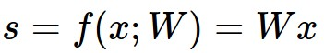
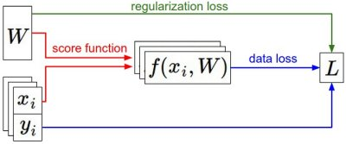
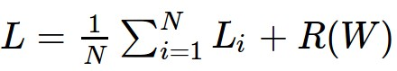
Recap
We have some dataset of (x,y)
We have a score function:
We have a loss function:
e.g.
Softmax
SVM
Full loss
Slide Credit: Fei-Fei Li, Justin Johnson, Serena Yeung, CS 231n

Slide 33
Recap
How do we find the best W?
Back-propogation, etc. Not covered here
We have some dataset of (x,y)
We have a score function:
We have a loss function:
e.g.
Softmax
SVM
Full loss
Slide Credit: Fei-Fei Li, Justin Johnson, Serena Yeung, CS 231n

Slide 34
How does a Neural Network Model Works?

Slide 35
So far: Linear Classifiers
Class scores
f(x) = Wx

Slide 36
Hard cases for a linear classifier
Class 1:
First and third quadrants
Class 2:
Second and fourth quadrants
Class 1:
1 <= L2 norm <= 2
Class 2:
Everything else
Class 1:
Three modes
Class 2:
Everything else
Slide Credit: Fei-Fei Li, Justin Johnson, Serena Yeung, CS 231n

Slide 37
Aside: Image Features
f(x) = Wx
Class scores
Feature Representation
Slide Credit: Fei-Fei Li, Justin Johnson, Serena Yeung, CS 231n

Slide 38
Image Features: Motivation
y
x
Cannot separate red and blue points with linear classifier
Slide Credit: Fei-Fei Li, Justin Johnson, Serena Yeung, CS 231n

Slide 39
Image Features: Motivation
y
θ
f(x, y) = (r(x, y), θ(x, y))
x
r
Cannot separate red and blue points with linear classifier
After applying feature transform, points can be separated by linear classifier
Slide Credit: Fei-Fei Li, Justin Johnson, Serena Yeung, CS 231n

Slide 40

Example: Color Histogram
+1
Slide Credit: Fei-Fei Li, Justin Johnson, Serena Yeung, CS 231n

Slide 41

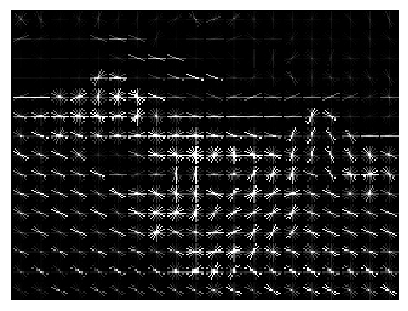
Example: Histogram of Oriented Gradients (HoG)
Divide image into 8x8 pixel regions
Within each region quantize edge direction into 9 bins
Example: 320x240 image gets divided into 40x30 bins; in each bin there are 9 numbers so feature vector has 30*40*9 = 10,800 numbers
Lowe, “Object recognition from local scale-invariant features”, ICCV 1999
Dalal and Triggs, "Histograms of oriented gradients for human detection," CVPR 2005
Slide Credit: Fei-Fei Li, Justin Johnson, Serena Yeung, CS 231n

Slide 42

Image features vs Neural Nets
f
Feature Extraction
10 numbers giving scores for classes
training
Krizhevsky, Sutskever, and Hinton, “Imagenet classification with deep convolutional neural networks”, NIPS 2012.
Figure copyright Krizhevsky, Sutskever, and Hinton, 2012. Reproduced with permission.
10 numbers giving scores for classes
training
Slide Credit: Fei-Fei Li, Justin Johnson, Serena Yeung, CS 231n

Slide 43
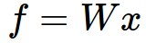
Neural networks: without the brain stuff
(Before) Linear score function:
Slide Credit: Fei-Fei Li, Justin Johnson, Serena Yeung, CS 231n
Notes:
Have been using linear score function as running example of function to optimize

Slide 44
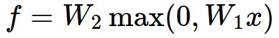
Neural networks: without the brain stuff
(Before) Linear score function:
(Now) 2-layer Neural Network
Slide Credit: Fei-Fei Li, Justin Johnson, Serena Yeung, CS 231n
Notes:
Instead of using single linear transformation, stack 2 together, get 2-layer network

Slide 45
Neural networks: without the brain stuff
(Before) Linear score function:
(Now) 2-layer Neural Network
x
h
W1
W2
s
3072
100
10
Slide Credit: Fei-Fei Li, Justin Johnson, Serena Yeung, CS 231n
Notes:
First have W1*x, then nonlinear function, then second linear layer
More broadly speaking, NN are class of functions where simpler functions are stacked on top of each other in a hierarchical way to make up a more complex, nonlinear function. Have multiple stages of hierarchical computation.

Slide 46
Neural networks: without the brain stuff
(Before) Linear score function:
(Now) 2-layer Neural Network
x
h
W1
W2
s
3072
100
10
Slide Credit: Fei-Fei Li, Justin Johnson, Serena Yeung, CS 231n
Notes:
Biological inspirations to neurons in brain that we’ll discuss later
Looking at it mathematically first, one thing this can help solve, is if we look back to our linear score function, each row of W corresponded to a template
Problem that there can be only one template per class, can’t look for multiple modes
Now intermediate layers can represent anonymous templates that later get recombined
Intermediate layers anonymous templates that get recombined. solves mode problems

Slide 47
Neural networks: without the brain stuff
(Before) Linear score function:
(Now) 2-layer Neural Network
or 3-layer Neural Network
Slide Credit: Fei-Fei Li, Justin Johnson, Serena Yeung, CS 231n
Notes:
Can stack more of these layers to get deeper networks, where the term deep NN comes from

Slide 48


Multilayer Networks
Cascaded “neurons”
The output from one layer is the input to the next
Each layer has its own sets of weights
Image Credit: Andrej Karpathy, CS231n

Slide 49
Neural networks: Architectures
“3-layer Neural Net”, or
“2-hidden-layer Neural Net”
“2-layer Neural Net”, or
“1-hidden-layer Neural Net”
“Fully-connected” layers
Slide Credit: Fei-Fei Li, Justin Johnson, Serena Yeung, CS 231n

Slide 50
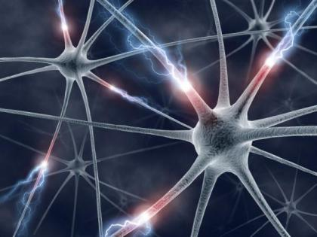
This image by Fotis Bobolas is licensed under CC-BY 2.0
Slide Credit: Fei-Fei Li, Justin Johnson, Serena Yeung, CS 231n
Notes:
Even though… still loosely inspired by brain, still interesting to understand where this comes from

Slide 51
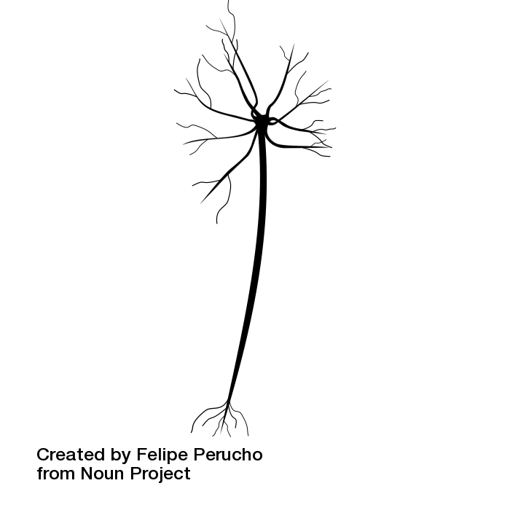
Impulses carried toward cell body
dendrite
presynaptic
terminal
axon
cell body
Impulses carried away from cell body
This image by Felipe Perucho
is licensed under CC-BY 3.0
Slide Credit: Fei-Fei Li, Justin Johnson, Serena Yeung, CS 231n

Slide 52

Impulses carried toward cell body
dendrite
presynaptic
terminal
axon
cell body
Impulses carried away from cell body
This image by Felipe Perucho
is licensed under CC-BY 3.0
Slide Credit: Fei-Fei Li, Justin Johnson, Serena Yeung, CS 231n

Slide 53
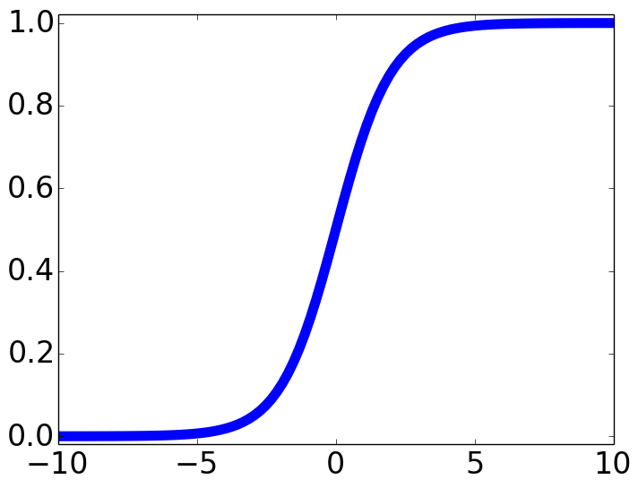
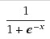
Impulses carried toward cell body
dendrite
presynaptic
terminal
axon
cell body
Impulses carried away from cell body
This image by Felipe Perucho
is licensed under CC-BY 3.0
sigmoid activation function
Slide Credit: Fei-Fei Li, Justin Johnson, Serena Yeung, CS 231n

Slide 54
Be very careful with your brain analogies!
Biological Neurons:
Many different types
Dendrites can perform complex non-linear computations
Synapses are not a single weight but a complex non-linear dynamical system
Rate code may not be adequate
[Dendritic Computation. London and Hausser]
Slide Credit: Fei-Fei Li, Justin Johnson, Serena Yeung, CS 231n

Slide 55
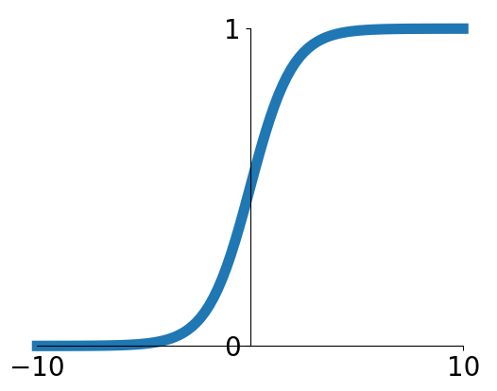
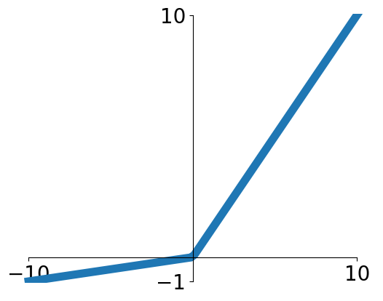
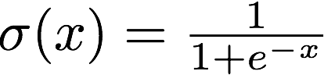
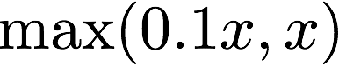
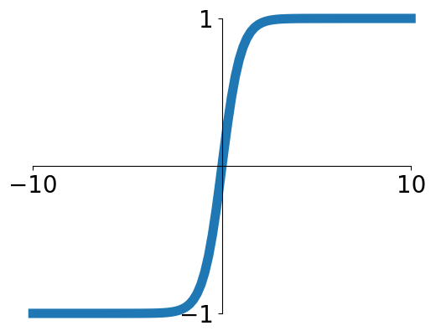
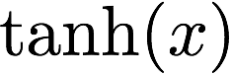
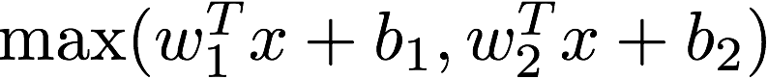
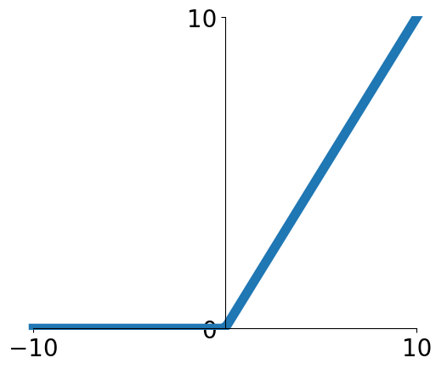
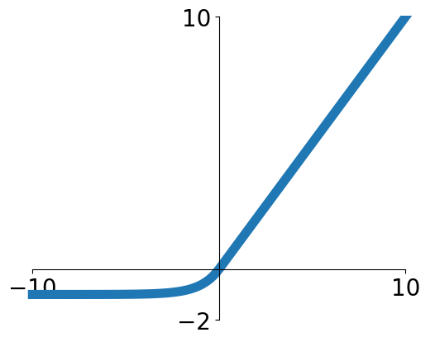
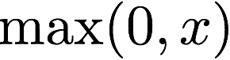
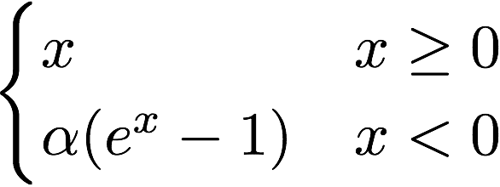
Activation functions
Sigmoid
Leaky ReLU
tanh
Maxout
ReLU
ELU
Slide Credit: Fei-Fei Li, Justin Johnson, Serena Yeung, CS 231n

Slide 56
Potential Extensions of Neural Network Models: Unsupervised Learning

Slide 57
Types of Learning
Supervised learning
Learning from a “teacher”
Training data includes desired outputs
Reinforcement learning
Learning to act under delayed evaluative feedback (rewards)
Unsupervised learning
Discover structure in data
Training data does not include desired outputs

Slide 58
Supervised vs Reinforcement vs Unsupervised Learning
Supervised Learning
Data: (x, y)
x is data, y is label
Goal: Learn a function to map x → y
Examples: Classification, regression, object detection, semantic segmentation, image captioning, etc.
Unsupervised Learning
Data: x
Just data, no labels!
Goal: Learn some underlying hidden structure of the data
Examples: Clustering, dimensionality reduction, feature learning, density estimation, etc.
Training data is cheap
Holy grail: Solve unsupervised learning
=> understand structure of visual world
Slide Credit: Fei-Fei Li, Justin Johnson, Serena Yeung, CS 231n
Notes:
To summarize differences, sup uses labeled data to learn a function mapping from x to y
Unsup uses no labels, tries to learn some underlying hidden structure of the data, whether grouping, axes of variation, underlying density

Slide 59
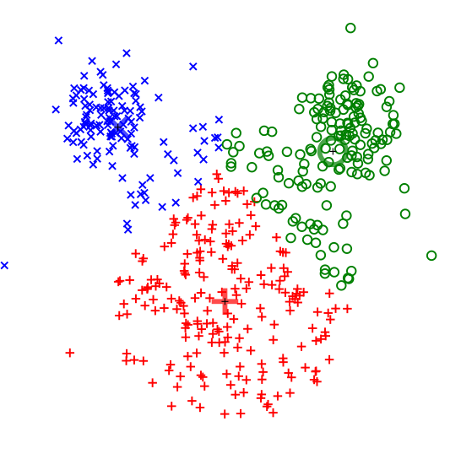
Supervised vs Reinforcement vs Unsupervised Learning
Unsupervised Learning
Data: x
Just data, no labels!
Goal: Learn some underlying hidden structure of the data
Examples: Clustering, dimensionality reduction, feature learning, density estimation, etc.
K-means clustering
This image is CC0 public domain
Slide Credit: Fei-Fei Li, Justin Johnson, Serena Yeung, CS 231n
Notes:
Clustering - find groups within the data that are similar through some metric

Slide 60

Supervised vs Reinforcement vs Unsupervised Learning
Unsupervised Learning
Data: x
Just data, no labels!
Goal: Learn some underlying hidden structure of the data
Examples: Clustering, dimensionality reduction, feature learning, density estimation, etc.
3-d
2-d
Principal Component Analysis
(Dimensionality reduction)
This image from Matthias Scholz is CC0 public domain
Slide Credit: Fei-Fei Li, Justin Johnson, Serena Yeung, CS 231n
Notes:
Find axes along which the data has most variation, this is part of the underlying structure of the data
Use this to reduce the dimensionality of the data such that the data has significant variation among each remaining dimension
Here is an example, take 3d data, finding 2 axes of variatiation and reducing dimensionality to 2d

Slide 61
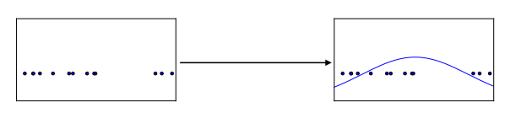


Supervised vs Reinforcement vs Unsupervised Learning
Unsupervised Learning
Data: x
Just data, no labels!
Goal: Learn some underlying hidden structure of the data
Examples: Clustering, dimensionality reduction, feature learning, density estimation, etc.
Figure copyright Ian Goodfellow, 2016. Reproduced with permission.
1-d density estimation
2-d density estimation
2-d density images left and right are CC0 public domain
Slide Credit: Fei-Fei Li, Justin Johnson, Serena Yeung, CS 231n
Notes:
Finally, another example is density estimation, which is estimating the underlying distribution of your data.
For example, in top example, have points in 1-d, and we can try to fit a gaussian to the density
In the bottom example, have 2d data. Again trying to estimate the density, and we model the density to be higher where more points are concentrated

Slide 62






Generative Models
Given training data, generate new samples from same distribution
Training data ~ p_{data}(x)
Generated samples ~ p_{model}(x)
Want to learn p_{model}(x) similar to p_{data}(x)
Slide Credit: Fei-Fei Li, Justin Johnson, Serena Yeung, CS 231n
Notes:
Today we’ll focus on generative models, a class of models for unsupervised learning that given training data, tries to generate new samples from the same distribution

Slide 63
Could be Described…
Goal: Variational Autoencoders
Latent variable probabilistic models
Example GMMs
Auto-encodeders
Variational Inference

